Slide 1
Insurance​​ Analytics Result
By Katayoon Mehr
30 May 2020

Slide 2
Outlines
Background
Objective (Hypothesis)
------------------------------------------------------------
Definition of Dataset of applicants/visitors
Data cleaning & Feature Engineering
Data Exploration
Descriptive Analysis – Distribution
Finding: Seasonal Conversion Rate
Definition of Dataset of Customers
Data cleaning & Feature Engineering
Descriptive Statistics – Distribution
Models: ANOVA – Linear Regression
Adaboost, Random Forest,
SVR and KNN
---------------------------------------------------------Conclusion

Slide 3
Back ground
The insurance company website provides the potential customers an application to be downloaded and quote on different type of insurance.
The times of installation and getting quote are recorded. If the applicant is interested in the quote would request to be contacted by an agent from sales team.
The time of contact by sale team is also recorded and if the applicant finds everything appealing and relevant would purchase the insurance. At this point the customer is sold. The time of sale is also recorded.
For the clients, there is another dataset with some personal information and their premium.
Objective (Hypothesis):
We are interested to know:
- The conversion rate of sale (Is the conversion rate vary in different seasons?)
- The effect of each action recorded time on sale (Does the date/time of app installation, quote, contact by agent affect the sale?)
- The features that affect the amount of premium.

Slide 4
Definition of Dataset of applicants/visitors
The dataset includes 5 variables:
“user_id” which is a unique id assigned to each user
“installation_at” is the UTC time that the user installed the app
“request_created_at” is the time at which the user first submitted a quote request. If null, a customer never submitted a quote request
“agent_responded_to_customer_at” is the time which sales agent picked up the account and began interacting with the customer. If null, the agent never responded to the customer (this is generally because they’ve indicated they’re not interested in the insurance policy)
“customer_sold_at” is the time which sales sold the account an insurance policy. If null, the customer was not sold.
Missing values
There are 132,296 applicants.
user_id 0
installation_at 6
request_created_at 33238
agent_responded_to_customer_at 57902
customer_sold_at 126555

Slide 5
Cleaning data & Feature Engineering
The missing values in the dates are not random missing. We should not remove or replace them. To be able to get the frequency of available date/time, we can replave Null with a value such as “No installation”, “No quote”, “No Contact” and “Not Sold”
All the dates are recorded ass YYYY-mm-dd HH:MM.
To be able to work on each aspect of time, it should be parsed to year, month, day, day of week, hour and minute

Slide 6
Data Exploration
Based on the missing data:
0.005% failed to install the app
74.88% got the quote after the app installation
56.23% of total applicants/visitors were contacted by an agent
75.10% of the applicants/visitors who got the quote were contacted by as agent. Similarly 24.90% were not interested to be contacted.
Sales Conversion rate is 4.34% (meaning only a bit more than 4 visitors/applicants in 100 visitors/applicants purchased the insurance.)
From 5741 individuals who purchased the insurance:
5 individual purchased the insurance without getting any quote,
43 individual purchased the insurance without being contacted by an agent.

Slide 7
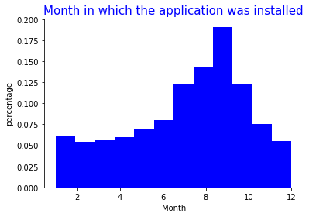
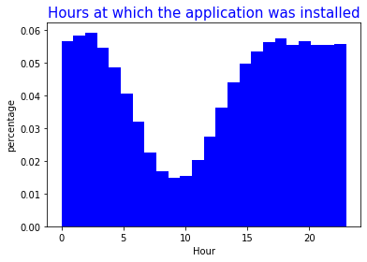
Descriptive Analysis - Distribution
Date and time of installation
The most installation happens in September, 53.15% of installation belongs to July, August, September and October. Winter and spring has less frequency of installation while summer and beginning of fall has the most.
The most installation happens in the evenings until late at nights. Early morning until noon has the lowest rate of installation.

Slide 8
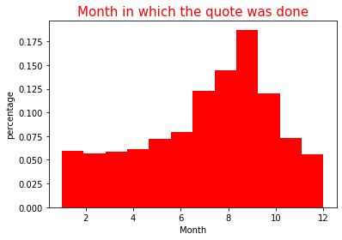
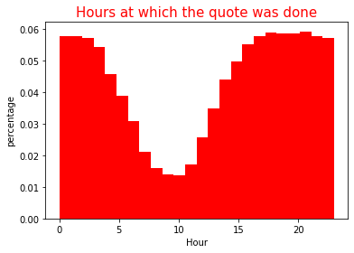
Descriptive Analysis - Distribution
Date and time of getting quote
Similar to installation, the most quote were taken in September, 52.63% of quotes belong to July, August, September and October. Winter and spring has less frequency of quote while summer and beginning of fall has the most.
The most quote happens in the evenings until late at nights. Early morning until noon has the lowest rate of quote.

Slide 9
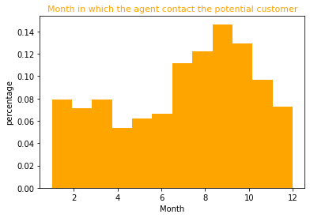
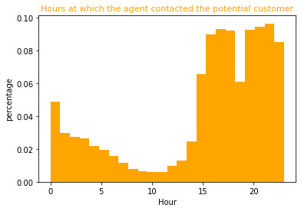
Descriptive Analysis - Distribution
Date and time of contact by a sales agent
Similar to installation and quote, the most contact was done in September, 46.71% of the contacts belong to July, August, September and October. Winter and spring has less frequency of contact while summer and fall has the most.
The most quote happens in the evenings until late at nights (after 4 pm until midnight with a drop around 7 pm which is the time of having dinner). Early morning (1:00 am) until afternoon (3:00 pm) has the lowest contact rate because it is the time for people to rest and then work.

Slide 10
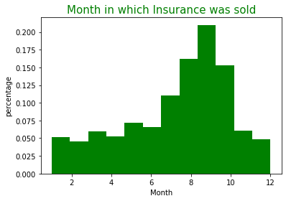
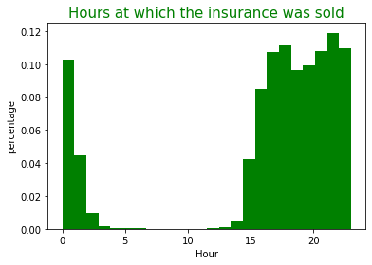
Descriptive Analysis - Distribution
Date and time of Sale
Similar to installation, quote and contact the most sales happened in September, 58.23% of sales belong to July, August, September and October. Winter and spring has less frequency of contact while summer and fall has the most.
The most sales happens in the evenings until late at nights (after 4 pm until midnight. Early morning (1:00 am) until afternoon (3:00 pm) has the lowest rate of sales because it is the time for people to rest and then work.

Slide 11
Descriptive Analysis - Distribution
Wednesday has the highest number of applicant for app installation, getting quote and being contacted. Tuesday and Thursday come next while as Friday is the best day for sale (24% of sales took place on Fridays). Based on the individuals behavior, they try the application and get the quote mostly in the middle of the week and those who are interested finalize it before the weekend. Sunday has the lowest rate of sale.

Slide 12
Descriptive Analysis - Distribution
At least 50% of the applicants/visitors made the purchase with less than 3 days of their installation and getting quote.
At least 50% of the applicants/visitors made the purchase at the same day or the day after the contact by an agent.
75% of the applicants/visitors made the purchase within 10 days of the agent’s contact.
“Strike while the iron is hot”

Slide 13

Findings: Seasonal Conversion Rate
Considering July, August and September as the best case scenario
41.85% of total applicants installed the app in summer which from them
74.17% got the Quotes which results in
46.38% interested applicants to be contacted by an agent. Which leads to
4.57% of sales.
Considering January, February and March as the worst best case scenario
15.72% of total applicants installed the app in winter which from them
76.69% got the Quotes which results in
75.18% interested applicants to be contacted by an agent. Which leads to
4.01% of sales.
Although people in summer installed the application almost 3 times more than winter time, the sales rate in only 13% more.

Slide 14
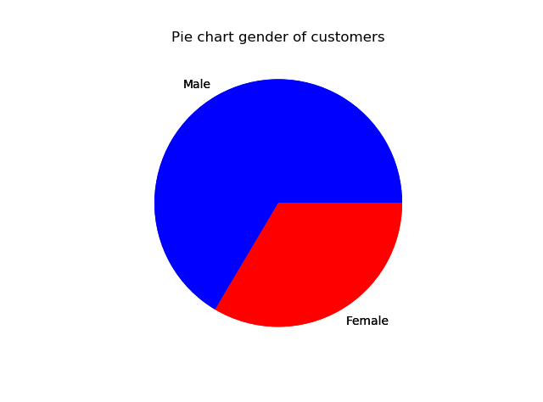
Definition of Dataset of Customers
Dataset of customers contains 9 columns: user_id, INS_id, City, Gender, Age, ins_Cancelation, Ticket, Accident and Premium. Ins_cancelation, Ticket and Accident are binary variables 1 and 0.
This tables is joined with the previous table (sold part only)to create the full dataset of customers.

Slide 15
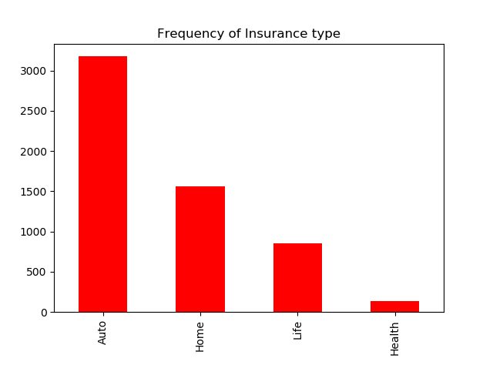
Data cleaning & Feature Engineering
There are few record with negative premium, these are customers who canceled their insurance due to change in their situation, so these records are removed.
For the variable INS_id, the first 2 characters shows the type of insurance. So to create another variable indicating the type of insurance, this variable is split.

Slide 16
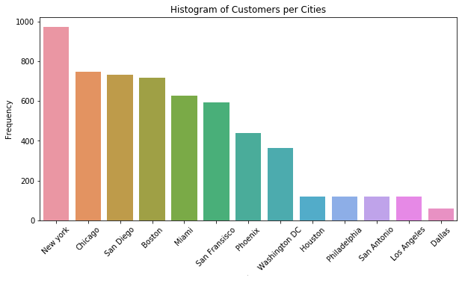
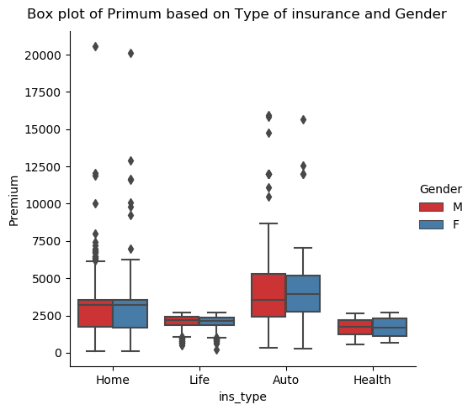
Descriptive Statistics - Distribution
The most customers are from New York city and the least from Dallas.
Auto insurance has the highest mean.
Auto and Home insurance have some outliers on upper side which belongs to luxury homes and cars.
Females have wider range for premium.
Life insurance have a few outliers on lower side. They can be those people who use some kind of subsidies or incentives from their work place.

Slide 17
Descriptive Statistics – City/Gender/Age and Premium
Los Angeles has the highest premium while Washington DC has the lowest.
Mean of Premium is the same for males and females.
Age are Premium have very low correlation (0.157)

Slide 18
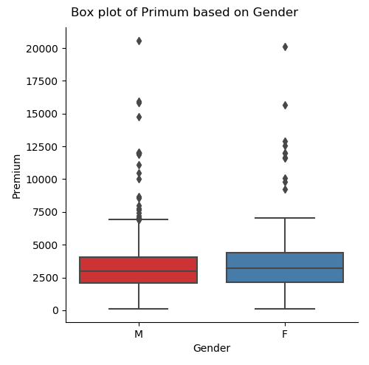
Descriptive Statistics – Gender & Ins_Cancelation/Ticket/Accident
Females have relatively higher rate of having accidents.
Rate of having ticket and insurance cancelation is close for both genders.
The premium for Auto insurance for both genders are close. That can be due to type of cars females drive (cheaper car, not sportive) compare to males.

Slide 19
Models: ANOVA – Linear Regression
For Auto insurance 8.25% has history of insurance cancelation 37.44 getting ticket and 16.66% accident.
Inc_Cancelation, Ticket and Accident are binary variable to understand their effects on premium, we use ANOVA test.
Using all the variables in the dataset 'City_C', 'Gender_C', 'Age', 'ins_Cancelation', 'Ticket', 'Accident', 'month_install', 'day_install', 'nday_install', 'hour_install', 'month_quote', 'day_quote', 'nday_quote', 'hour_quote', 'month_contact', 'day_contact', 'nday_contact', 'hour_contact', 'month_sold', 'day_sold', 'nday_sold', 'hour_sold’, only Inc_Cancelation, Ticket and Accident are significant, the R-square and adjusted R-square are pretty low.
Using Backward Regression, only Inc_Cancelation, Ticket and Accident and constant stay in the model. Y= 3305.85 + 350.99 * ins_Cancelation +1032.68 * Ticket+182.97 * Accident.
R-square for train is 31.46% and R-square for test is 33.67%.

Slide 20
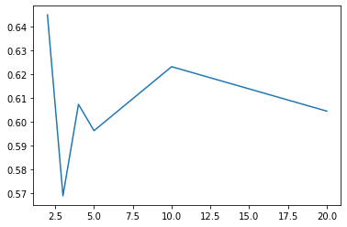
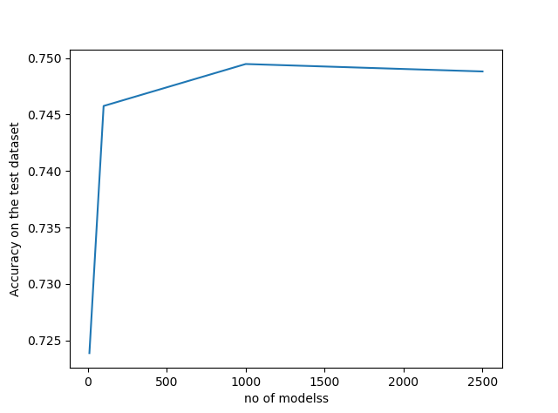
Models: Adaboost, Random Forest, SVR
Applying Adaboost model shows that the model is the best at n=10. the accuracy is about 62%.
Applying Random Forest model shows that the best model is a forest of n=1000 trees with accuracy of 75%.
Applying SVR model shows that the best model is for {'C': 1, 'gamma': 1, 'kernel': 'poly’} with accuracy of 60%.
Adaboost
Random Forest

Slide 21
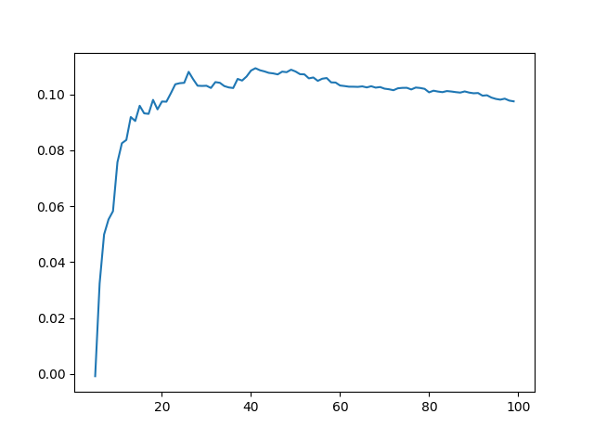
Models: KNN, SVR
Applying KNN model shows that the best model is for n=40. but the score is still very low (15%). And having too many classes in the model is not efficient.
Applying SVR model shows that the best model is for {'C': 1, 'gamma': 1, 'kernel': 'poly’} with accuracy of 60%.
KNN

Slide 22
Conclusion
The conversion rate is a little above 4%. Despite the fact the installation and getting quote in summer time is more, the conversion rate stay the same through the year.
The best practice for sales team is to contact the potential customers within maximum 2 days of their quotes.
The most insurance is sold for Auto and the City with the highest number of customers is New York. But Los Angeles has the highest rate of premium.
Although women have significantly more accident the rate of premium for Auto insurance is the same for both genders.
Premium for Auto is affected by the history of clients. If they have insurance cancelation, ticket or accident. But age, gender, city, time of installation, getting quote, being contacted by the agent or sale, does not affect the premium.
Between models that have fit on data, Linear Regression, Adaboost, Random Forest, KNN and SVR, Random Forest with n=1000 is the best. The accuracy is about 75%.

Slide 23
The End Thank you for your attention

